Slide 1

Reportal
Akshay - Celeste - Maha - Prateek - Pranay - Rafif - Sonali

Slide 2
Problem Statement
Public Incident Report is a web form that is open to all Stevens students, faculty, and staff for addressing incidents, concerns across Stevens campus. This platform does not have the feature to post the picture, get exact location of the incident and is also limited with web access.
Reportal allows users to report issues along with posting image with location details via android mobile application and get timely updates on issues from the maintenance team. The maintenance team will use webportal to manage the issues.

Slide 3

Project Description
Reportal is an Android application that aims to assist the Stevens community by providing an easy and interactive way for people to report issues on or around campus. The application will have two main interfaces, one for the public and the other is for the maintenance team.

Slide 4

Who Cares aka Target Audience
Stevens’ Students
Stevens’ Staff
Hoboken Community

Slide 5


Platform
Reportal app will be available on Android platform for users.
The maintenance team can access the admin portal via any browser.

Slide 6


Development Plan and Process
Project method used: Agile
Project management framework: Scrum
Communication tools used: Whatsapp & Gmail
Code collaboration tool used: Github
Weekly scrum/stand up meetings
Code reading and Pair programming methods used to review code and test cases

Slide 7
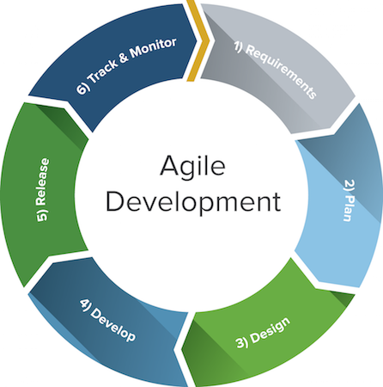

Development Process
Team used Agile methods while developing this project.
Continuous integration practice was followed and Github was used for code collaboration.
Team used the Feature driven development process to build the application.
Weekly scrum/stand up meetings were held to track the progress.

Slide 8

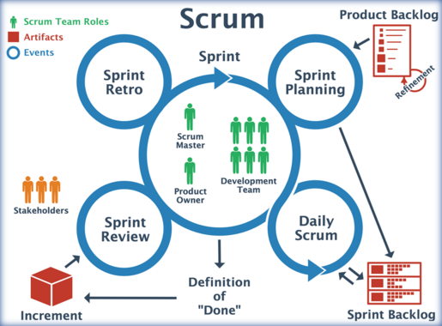
Communication Plan
Weekly scrum/stand up meetings
Scrum meetings took place every week at Altorfer or any other place depending on availability.
Each member shared the progress and the tasks at hand with the team.
The target and goals for the next scrum were decided and agreed upon in the meeting.
Team members worked after the meetings and collaborated together to review tasks and resolve issues.

Slide 9
Documents
Project plan document
Product backlog
API document

Slide 10
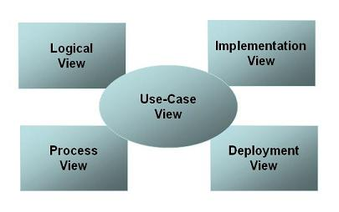
Architecture - 4+1 view

Slide 11
Use-Case View
Scenario
1- User Registers
2- User logs in
3- User posts an Issue
4- User views all posts
5- User views their post history

Slide 12
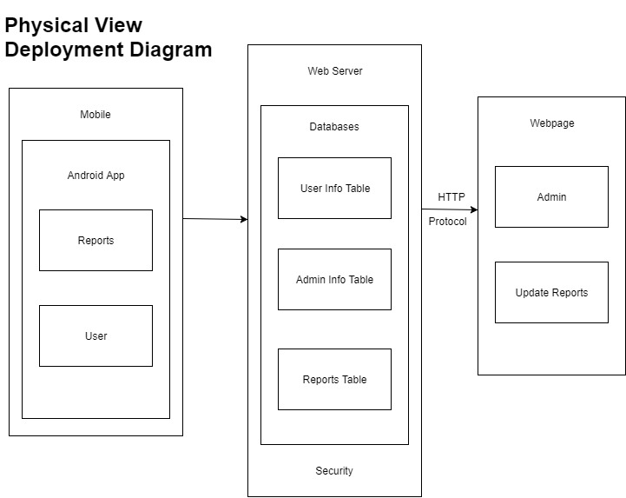
Physical View
Deployment
Diagram

Slide 13
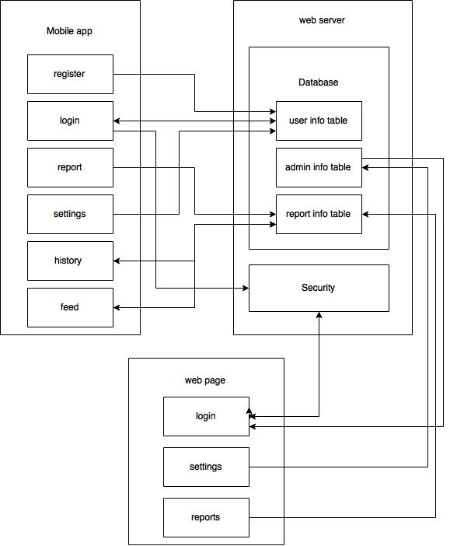
Development View
Component
Diagram

Slide 14
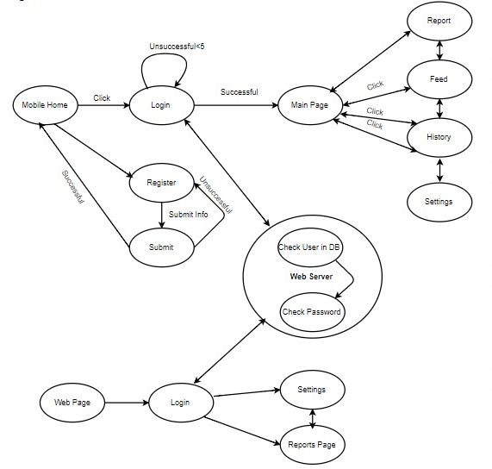
Logical View
State Diagram

Slide 15
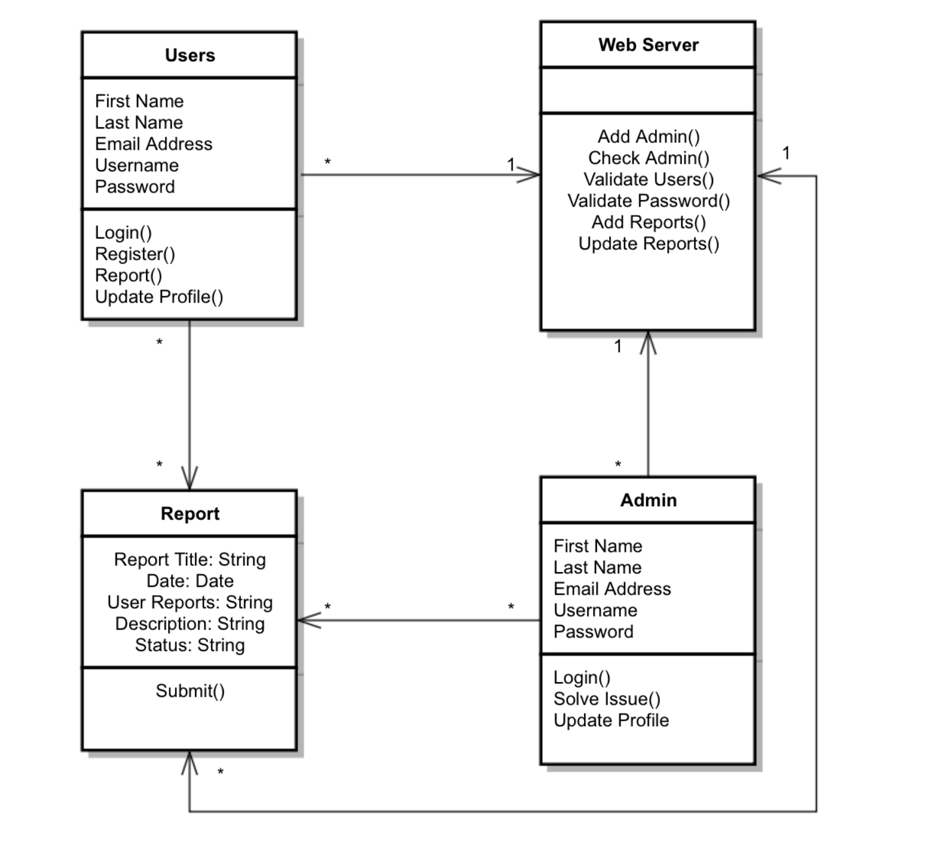
Logical View
Class
Diagram

Slide 16
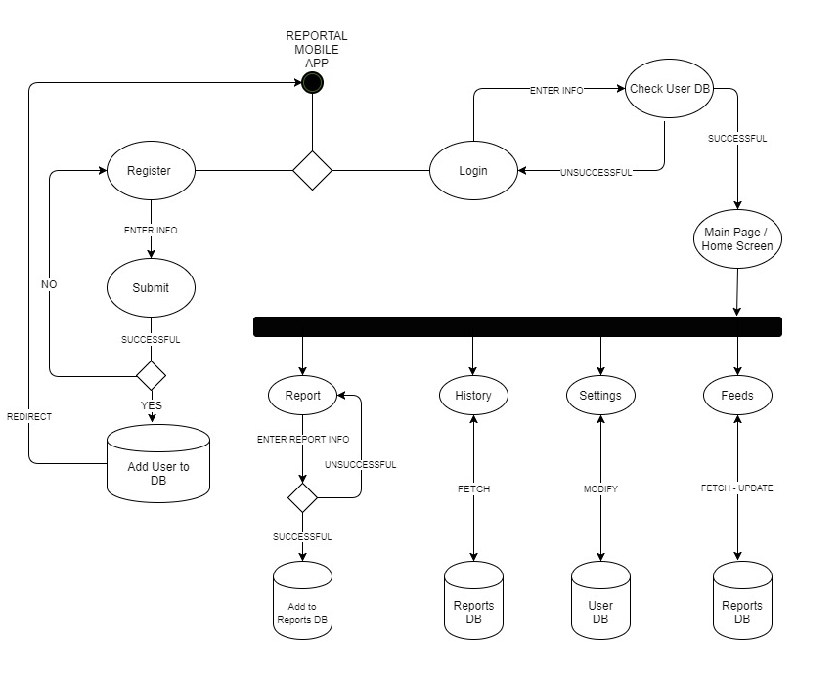
Process View
Activity Diagram

Slide 17
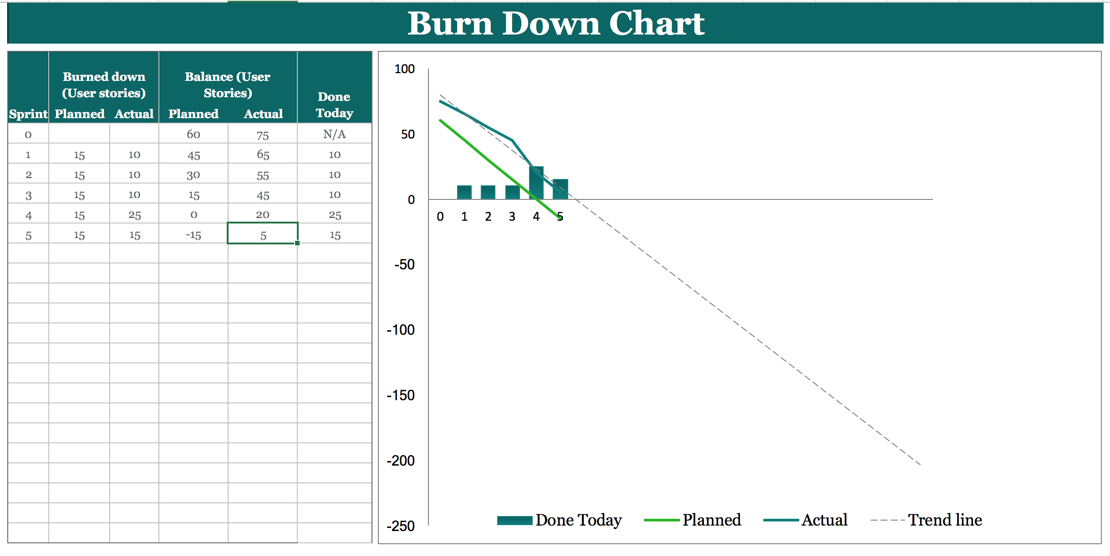
Burn down chart

Slide 18
Web Services
Pranay - Sonali

Slide 19






Web Services - Technology Used
Programming Language: Python
Web Framework: Flask, Flask_sqlalchemy
API Testing: Postman
File Transfer: Filezilla
Cloud Provider: AWS
Web Server: Nginx
Application Server: Gunicorn

Slide 20
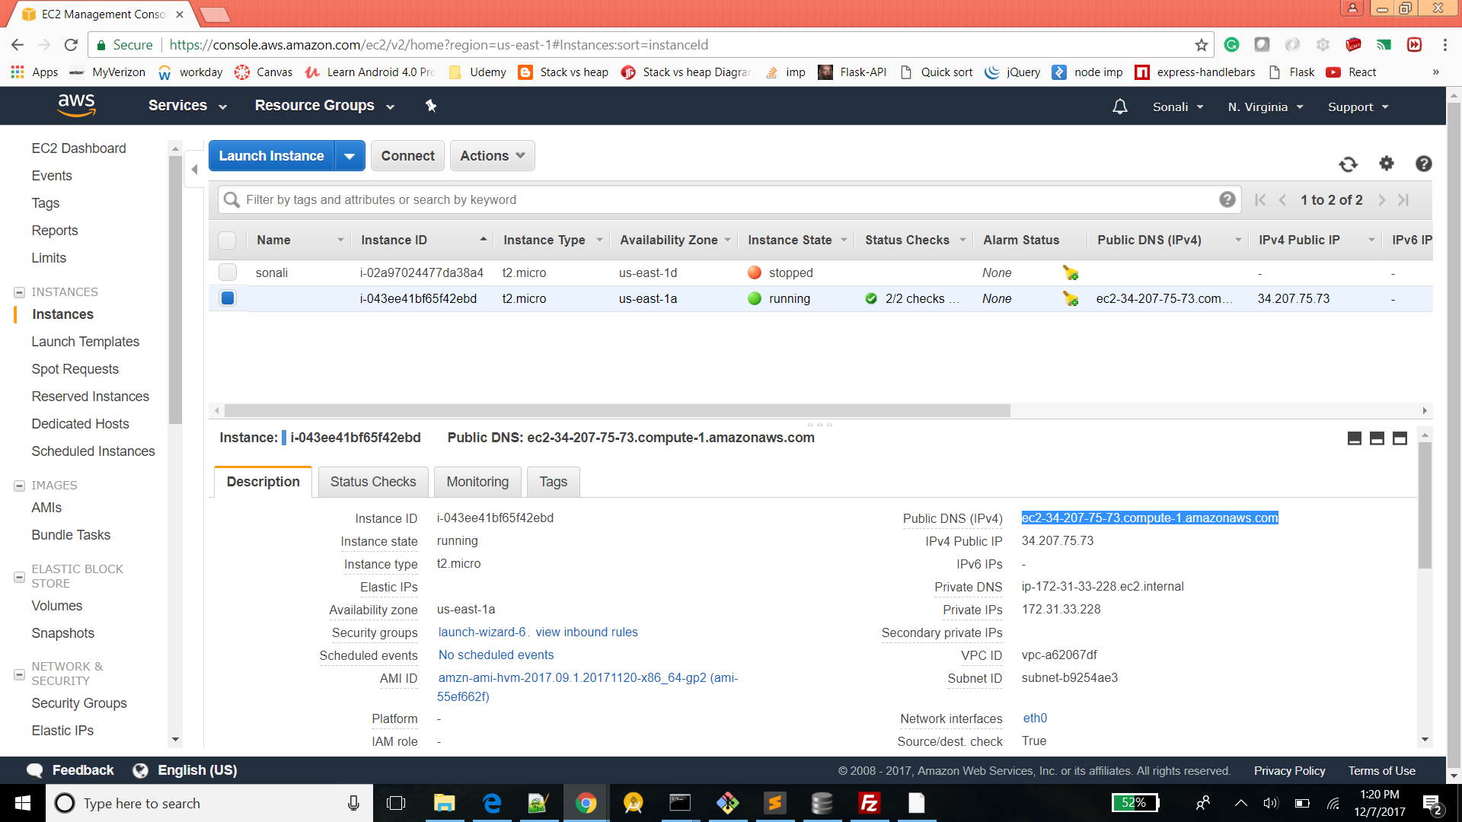
AWS EC2 Instance Console

Slide 21
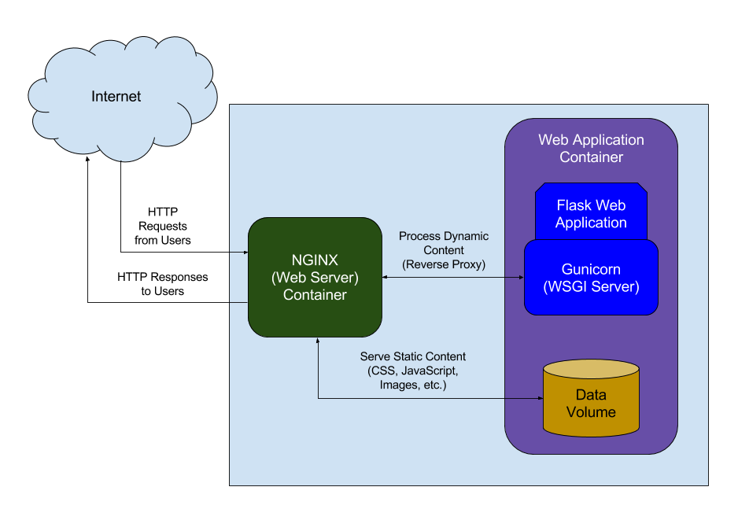
Server Architecture

Slide 22
Web Services
SPRINTS | API Endpoints
Sprint 1 | (1) /api/login (2) /api/register
Sprint 2 | (3)/api/update_user_settings (4) /api/get_user_list/<int:page> (5) /api/get_user/<int:user_id> (6) /api/priority (7) /api/category
Sprint 3 | (8) /api/logs (9) /api/get_notification/<int:user_id> (10) /api/delete_notification
Sprint 4 | (11) /api/get_priorities (12) /api/get_categories (13) /api/post_issue (14) /api/forgot_password
Sprint 5 | (15) /api/get_issue (16) /api/static/img/<string:folderName>/<string:filename> (17) /api/reset_password/<string:token> (18) /api/get_issue_list/<int:assignedToID> (19) /api/update_issue

Slide 23
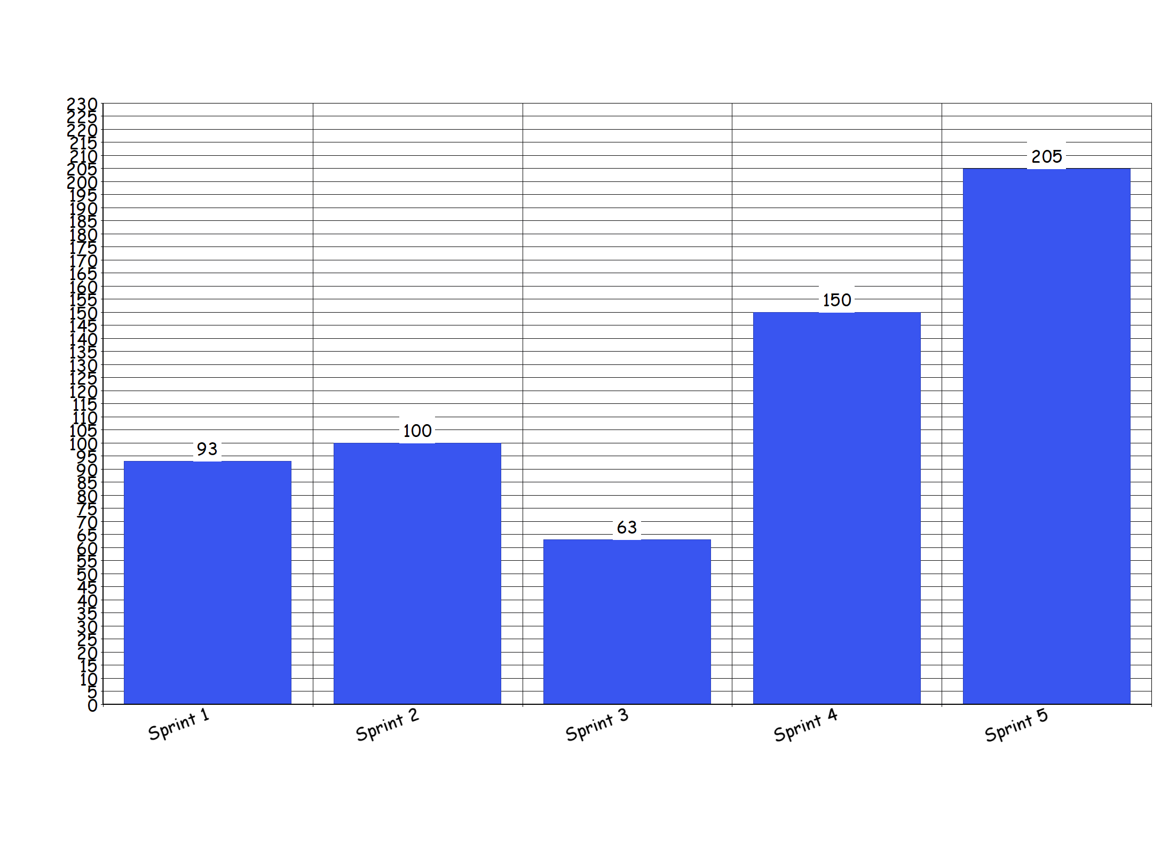
Web Services LOC/Sprint

Slide 24
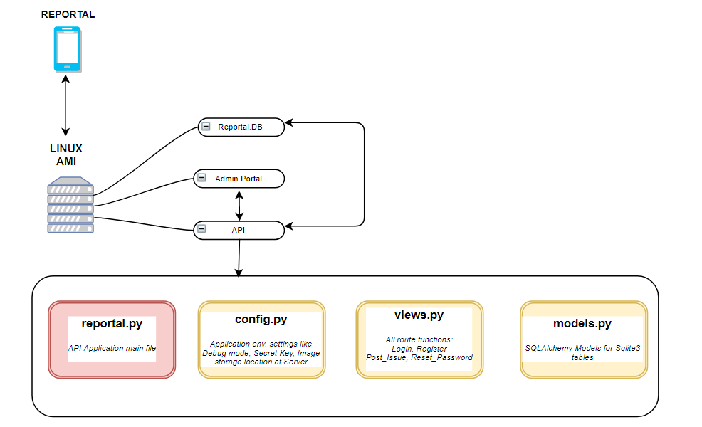
Web Services Structure

Slide 25
Function - Wise LLOC
Functions | Request Type | Logical LOC
login, register | POST | 93
category, priority, user_update_settings | POST, PUT | 100
logs, get_notification, delete_notification | GET, DELETE | 63
post_issue, get_issue_list, get_categories, get_priorities | GET, POST | 150
update_issue, get_issue, forgot_password, getPic | GET, POST | 205

Slide 26
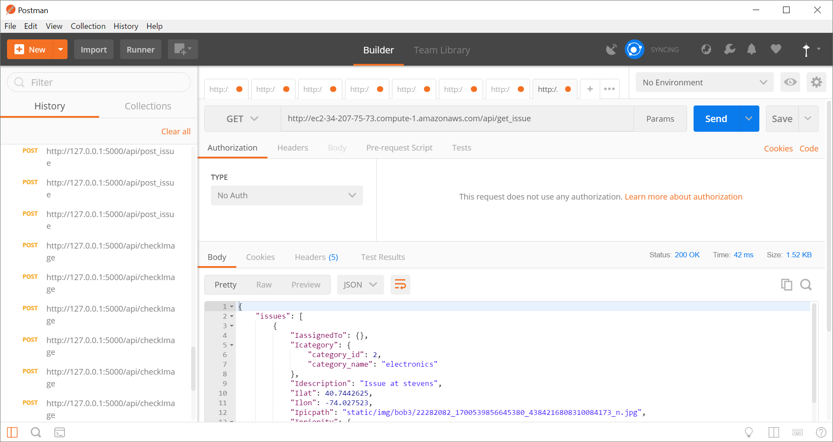
POSTMAN Web Service Testing - Get Issue

Slide 27
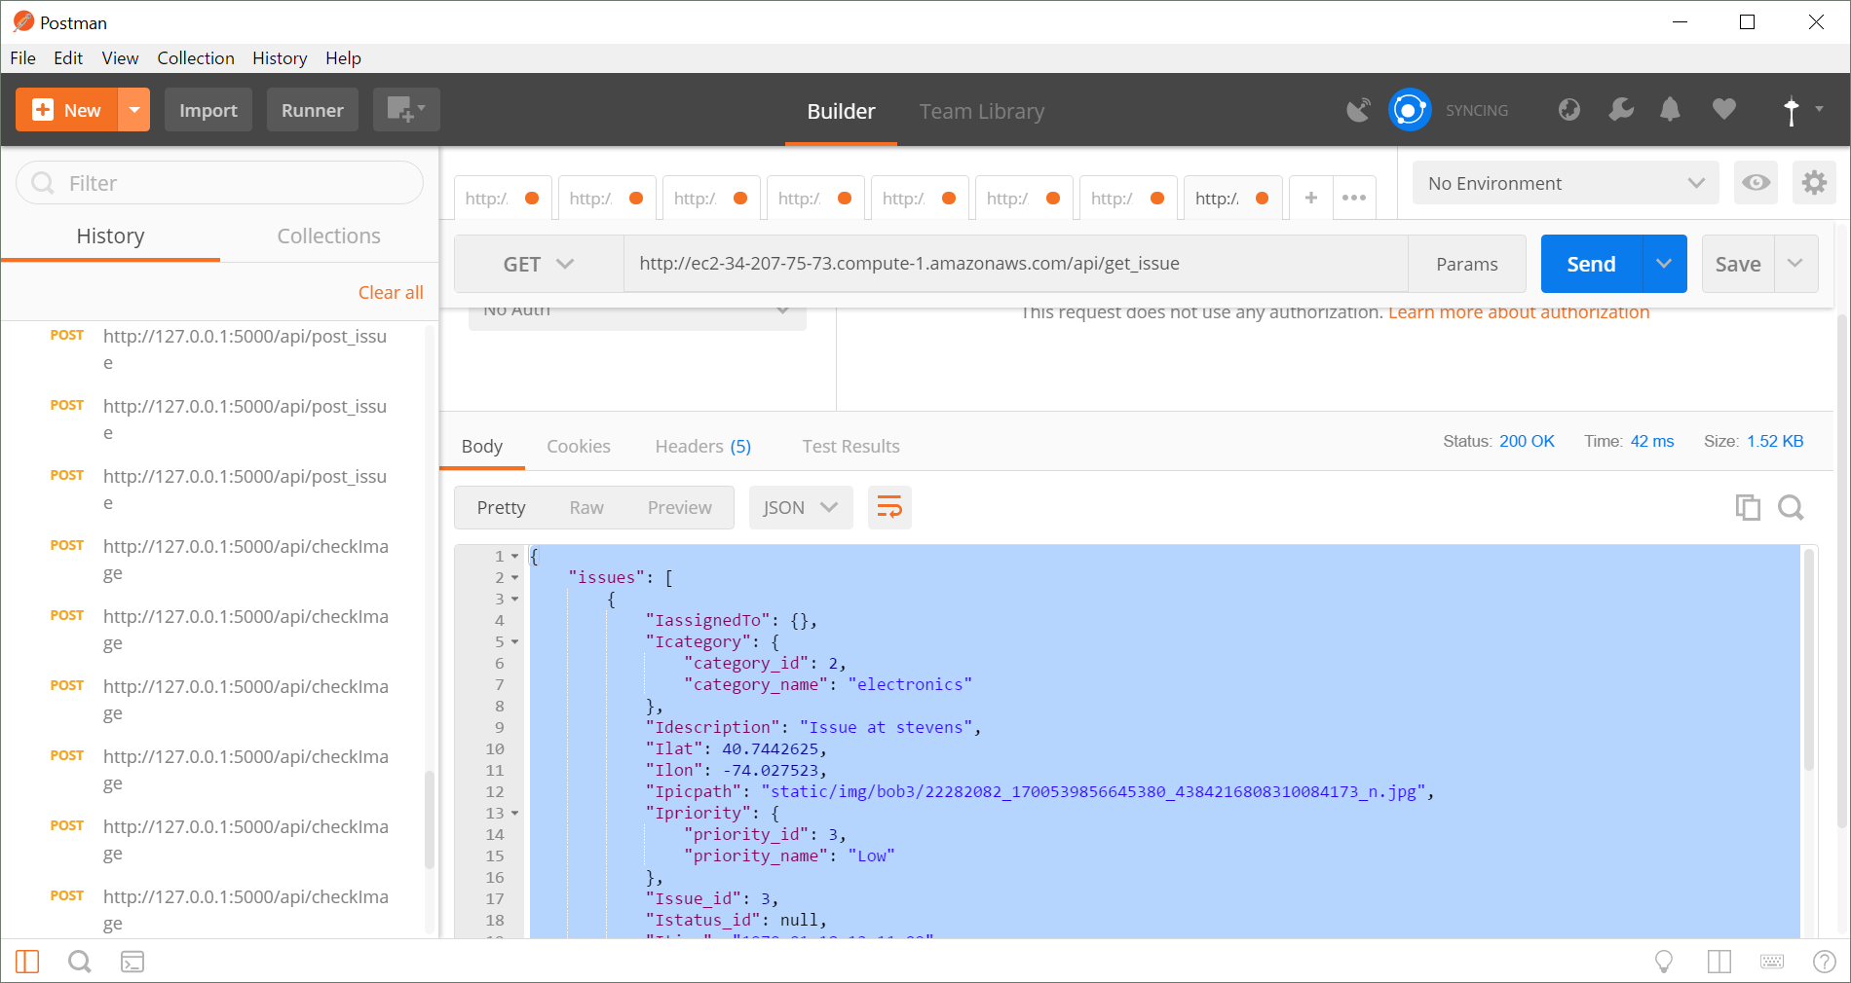
POSTMAN Web Service Testing - Get Issue contd..

Slide 28
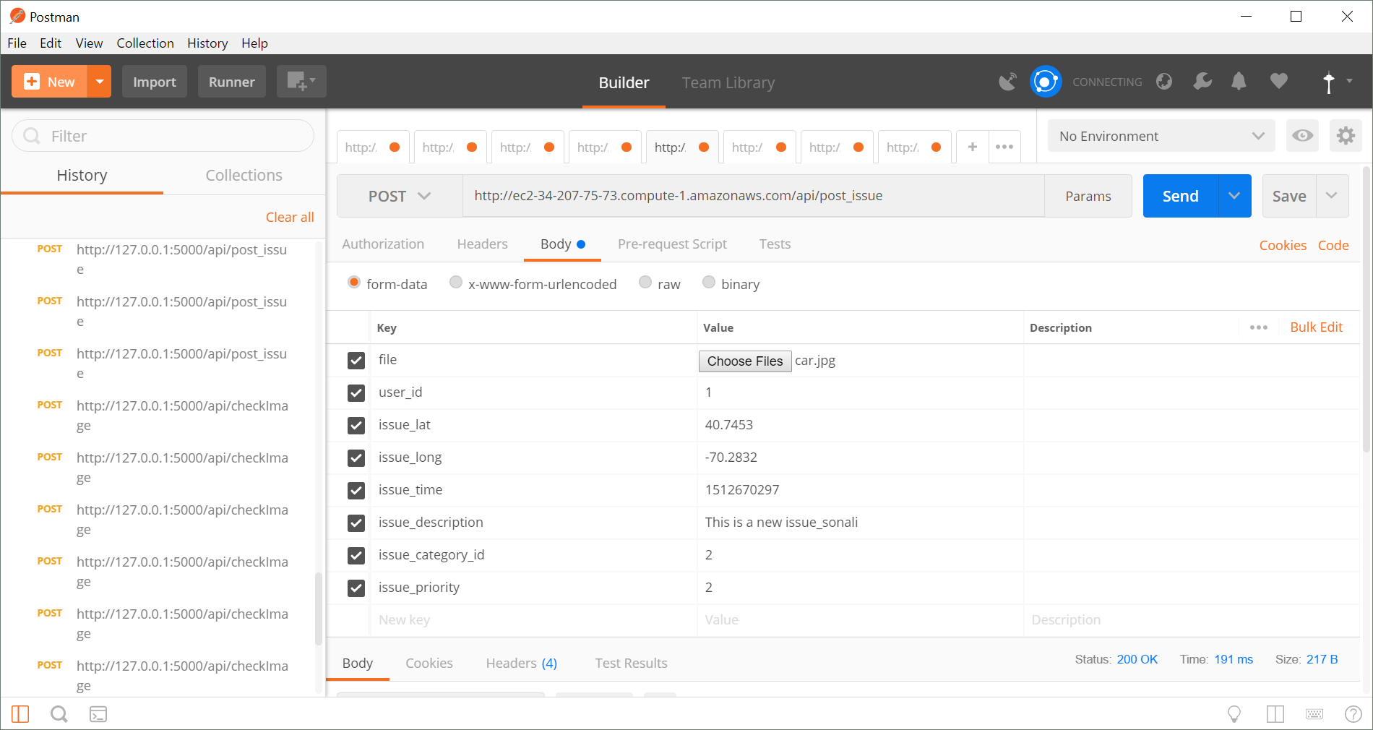
POSTMAN Web Service Testing - Post Issue

Slide 29
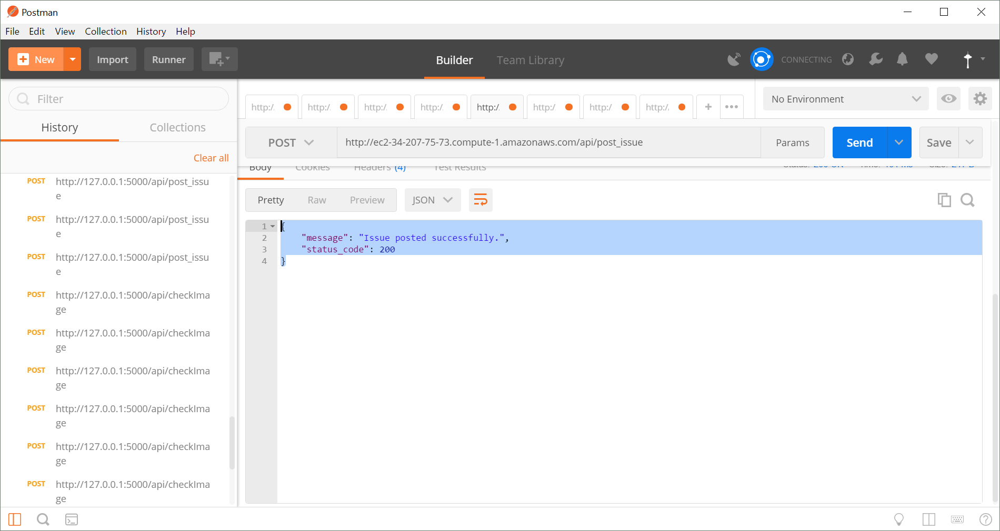
POSTMAN Web Service Testing - Post Issue

Slide 30
Android
Celeste - Prateek

Slide 31


Android - Technology Used
Reportal android application Android Studio
Programming Languages: xml, kotlin
Overview of design
Checking credentials
Connecting to server
Saving data

Slide 32
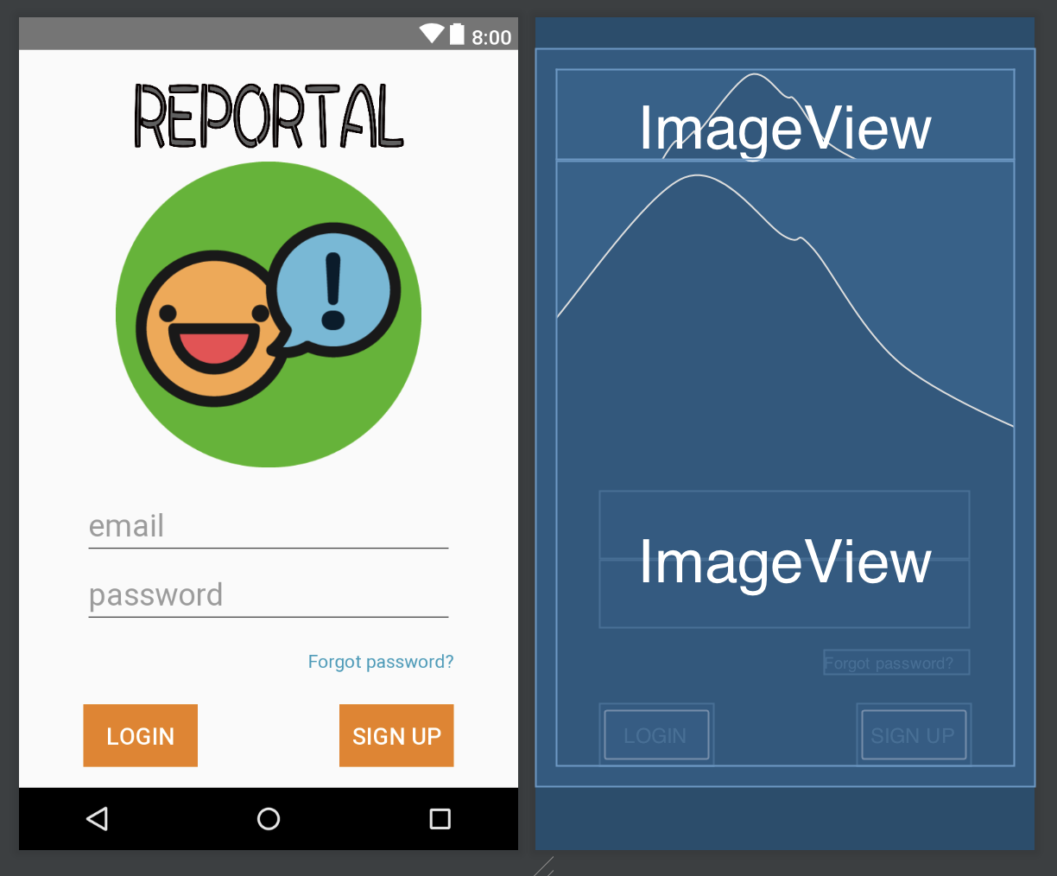
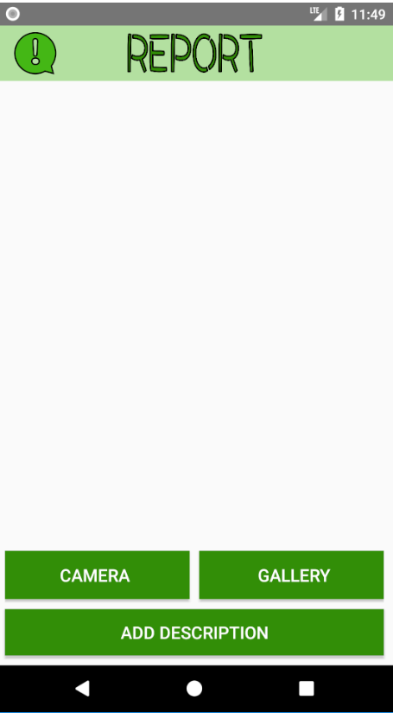
Android - Feature List
Login
Sign up
Forgot password
Post issue
View history
View Feed
Update settings

Slide 33
Reportal application design and development
Languages used:
Kotlin
XML
Development weeks: 10
Development hours per week: 8
Total LOC: 6,862
Build Rate: 85 lines of code per hour

Slide 34
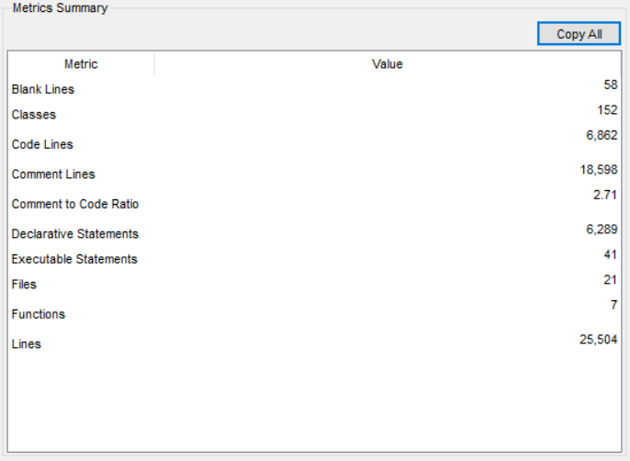
Android application code metrics

Slide 35
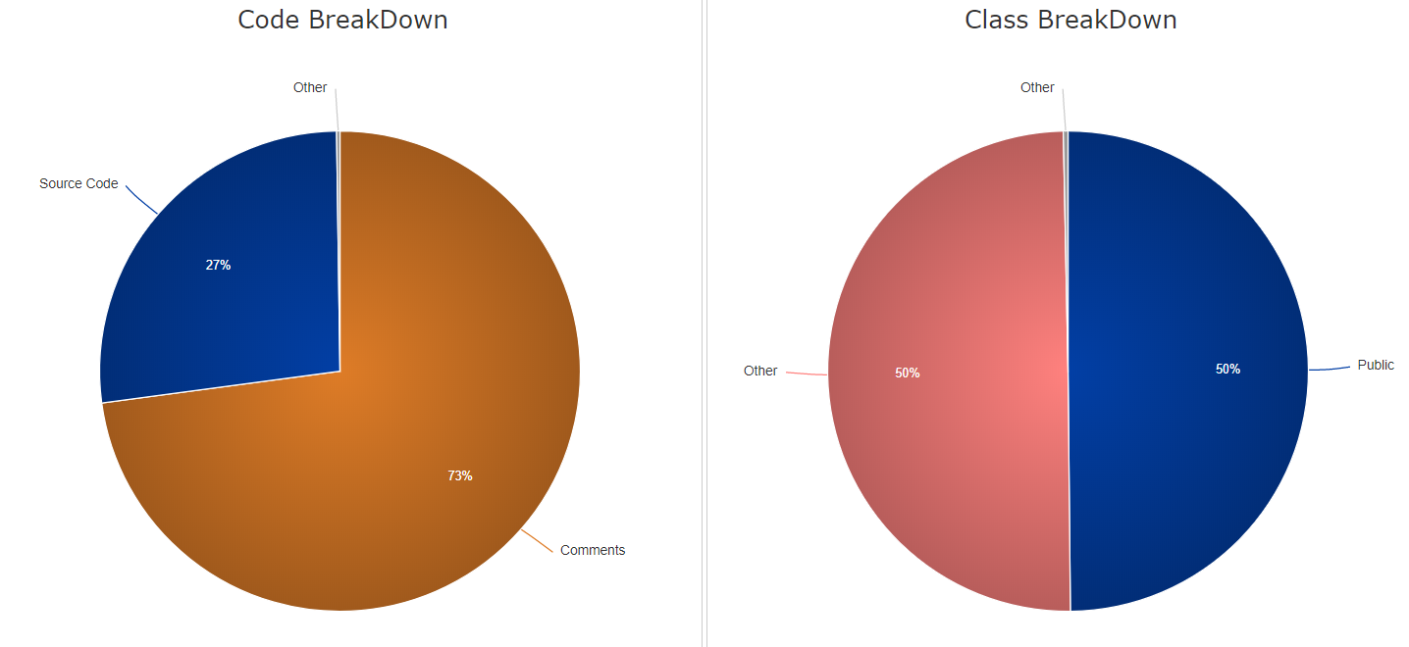
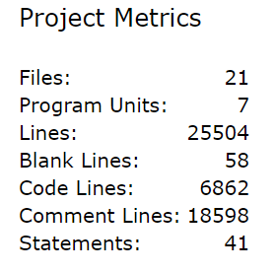
Android application code metric graphs

Slide 36
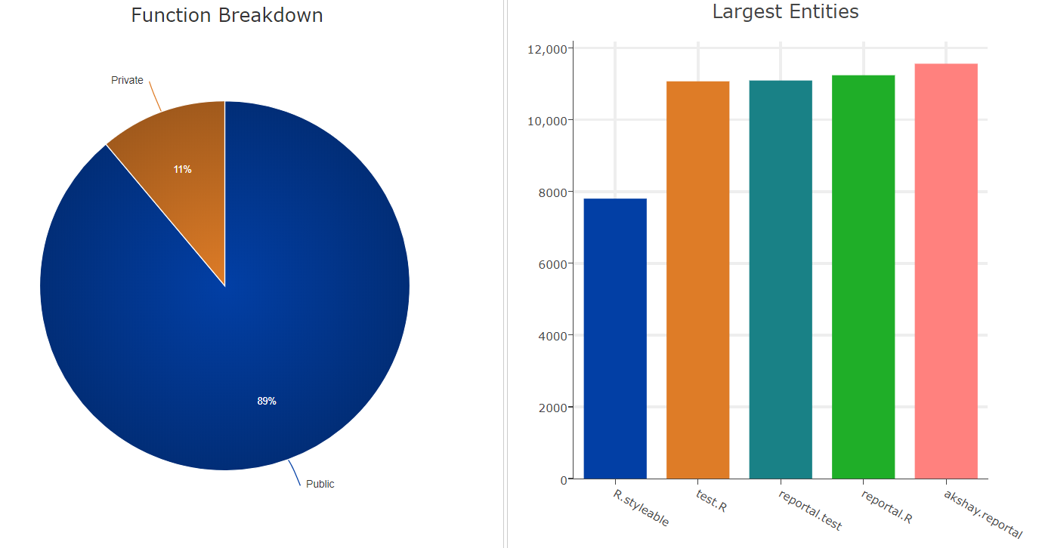
Android application code metric graphs

Slide 37
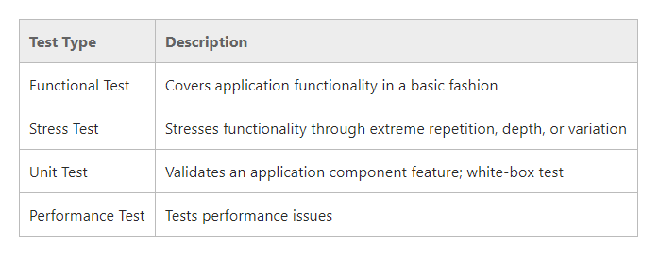
Reportal application testing

Slide 38
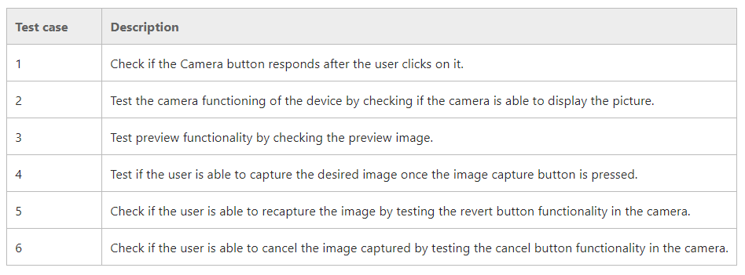
Reportal intent sample test cases

Slide 39
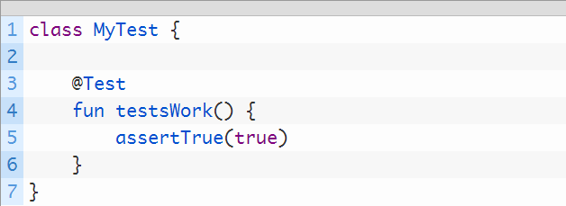
Reportal application camera intent testing
Unit Testing performed using jUnit.

Slide 40
CMS
Maha - Rafif

Slide 41





Admin portal - Technology used
Python
JavaScript
HTML - CSS
Flask
Jinja
Bootstrap

Slide 42
Admin portal - Feature List
Login
View (users, issues, categories, priorities)
update(issues, categories, priorities)
View profile
Update profile

Slide 43
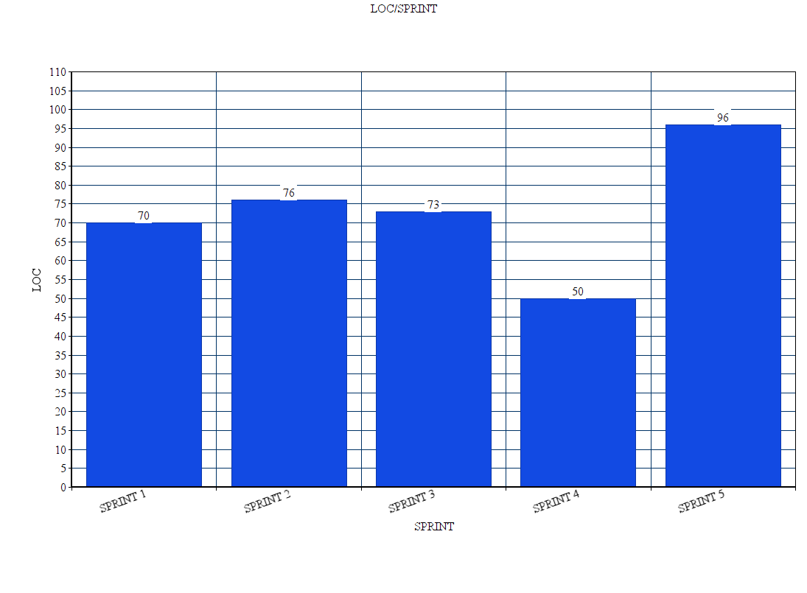
ADMIN PORTAL - LOC/ sprint

Slide 44
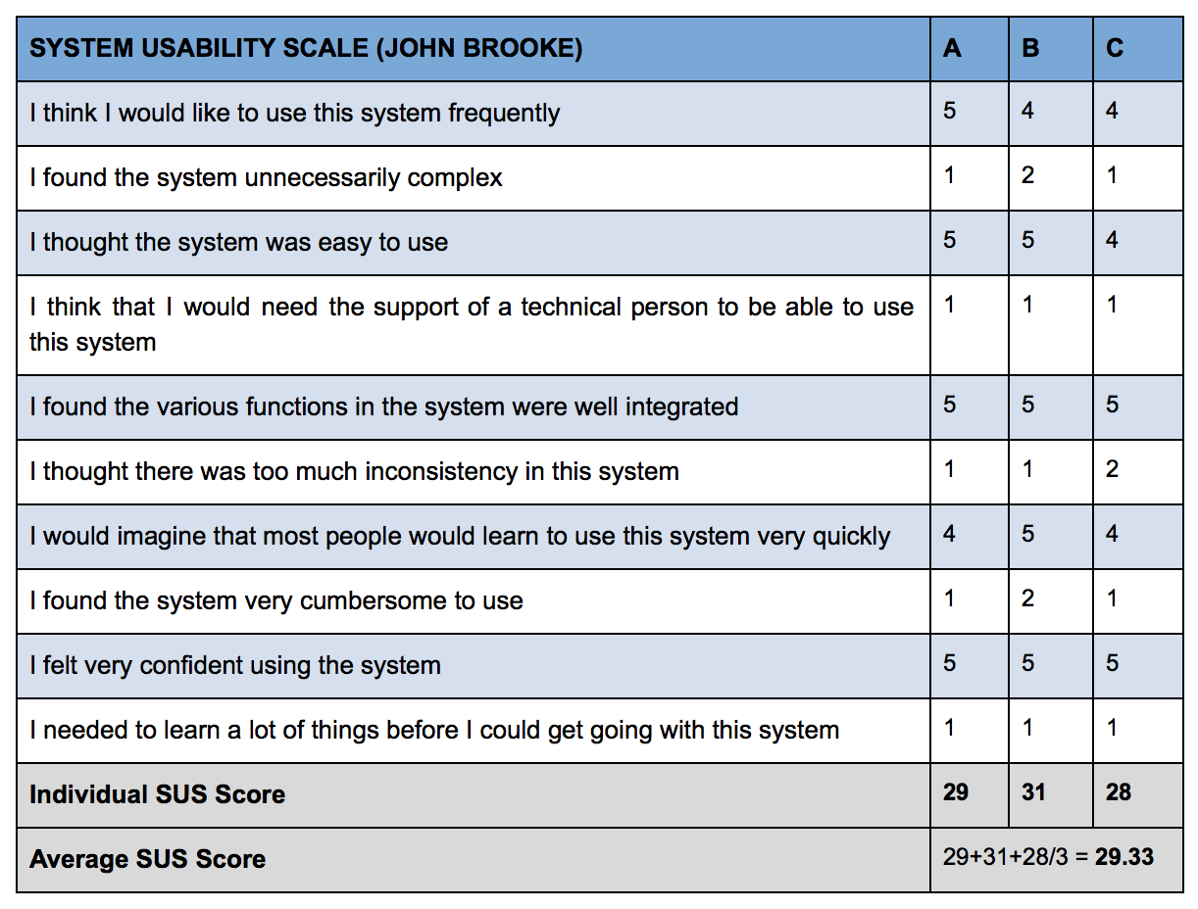
ADMIN PORTAL - USABILITY TESTING
We have chosen 3 different subjects with an average on computer savvy 4 out of 5 to perform one scenario task:
Log in to Reportal
View and update Profile
We have gathered some system usability scale (SUS) using JOHN BROOK scale. As a result, interpreted the Individual SUS score in order to analyze the measurement of our system. The result was successful as our score is above 80%.

Slide 45
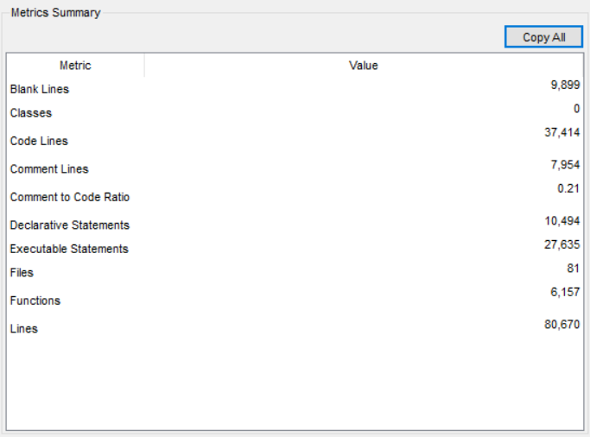
ADMIN PORTAL METRICS

Slide 46
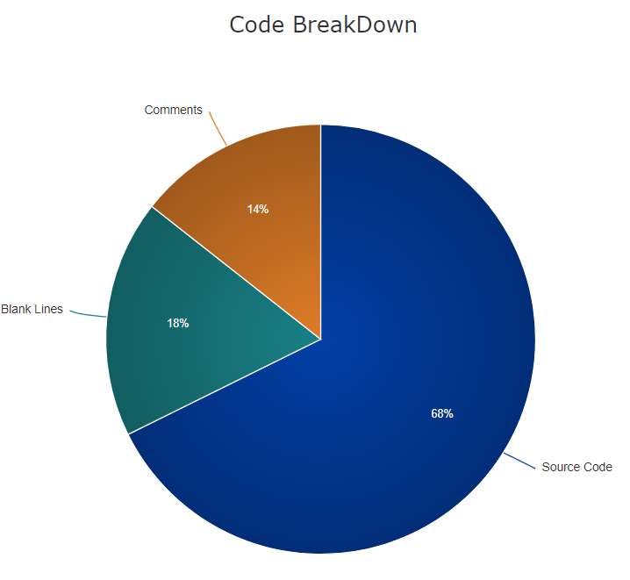
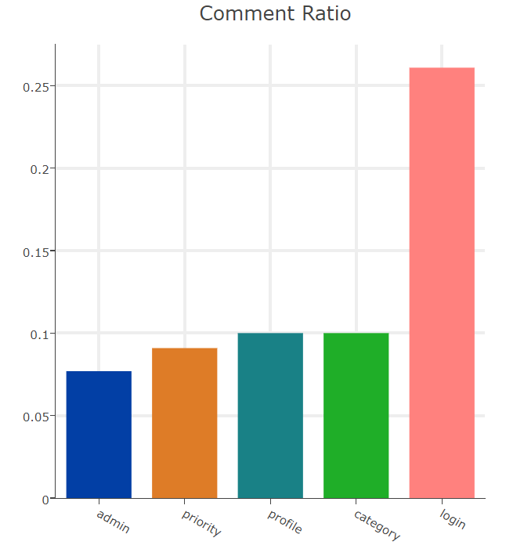
ADMIN PORTAL GRAPHS

Slide 47
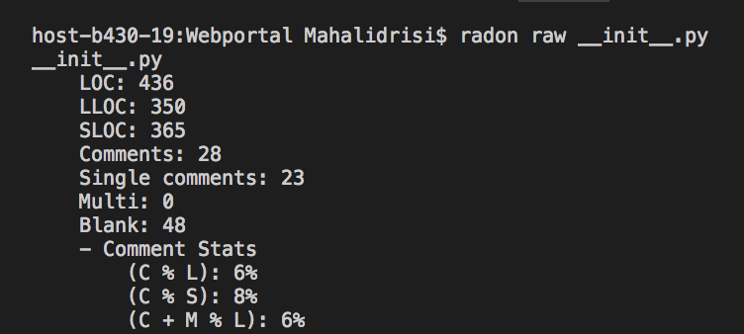
ADMIN PORTAL - TOTAL LOC

Slide 48
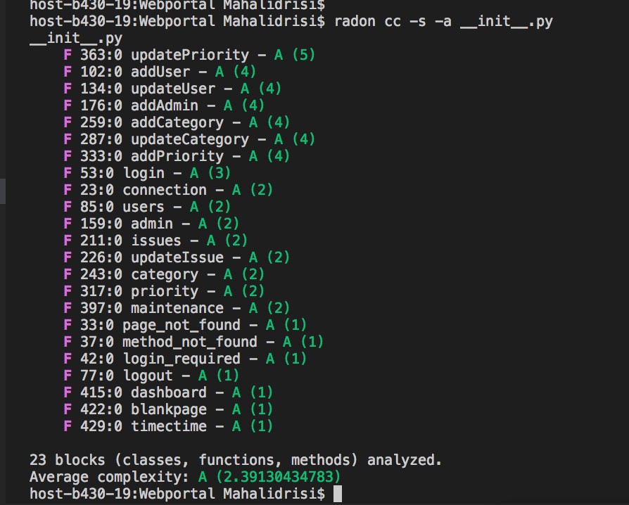
ADMIN PORTAL - CYCLOMATIC COMPLEXITY

Slide 49


What went well?
Learnt and explored new technologies, softwares and programming languages.
Regular meetings and communication helped in resolving issues.
Improved team-player and collaborative skills.

Slide 50

What went bad?
Integration
Estimate user stories
Estimate story points
Slow start
Irregular meetings
Amazon instance issue

Slide 51

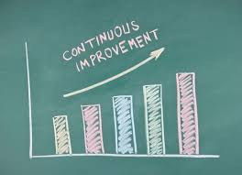
Things to improve
Continuous integration.
Code collaboration.
Decision making and tasks organization.

Slide 52


Code Repository
The full code repository can be found on Github.
Github link: https://github.com/akshya672222/SSW695_Team7

Slide 53
Next Version
The application has a certain potential to go live and used by the Stevens’ and Hoboken community. In order to make the application operational, a certain amount of investment and time would be required to make it a success.
Current version of the app has not been scaled with a lot of users. Also, to make this application operational, the team would require to make it available for download on Play stores.

Slide 54


Next Version
The next version of this application will also include an iOS version to cater apple products and users along with android.
Reportal 2.0 will also include some additional features like auto detecting of location, contact services directly, have an emergency alert button, sharing the issue on social media etc.
The application will also decrease bugs/issues faced in real time by users in the next version.

Slide 55

Future Work
The future scope for the application is immense.
Number of functionalities and features can be added to the app.
If given an opportunity, the team will surely like to work and add more features like auto-detecting the location, sharing the issue on social media etc.
The team highly recommends to take up and continue this amazing project.

Slide 56


Special Thanks to professor Vesonder
Thank you
Questions?

